Slide 1
Global Visualization of Tweets about COVID-19
Allison Oborn | Timothy Stander | Leonardo Craven

Slide 2

Our goal:
Produce an intriguing visualization of tweets about COVID-19 and show how the information spread globally

Slide 3
The Data
We got our data from ieee-dataport.org, and then we hydrated the data using Twitter’s developer tools.
This produced a json file that had all the tweets from a certain time period across the globe.
We then compiled all the data that had geolocation in one file and then figured out how many tweets were sent from each longitude and latitude point.

Slide 4



Tools/Libraries
We used a lot of tools available at cesium.com
Cesium is a platform for 3D Geospatial visualization, so it was very helpful in being able to display the global data.
We also used Nodejs to host our web server and the Twitter developer tools to hydrate the data.

Slide 5
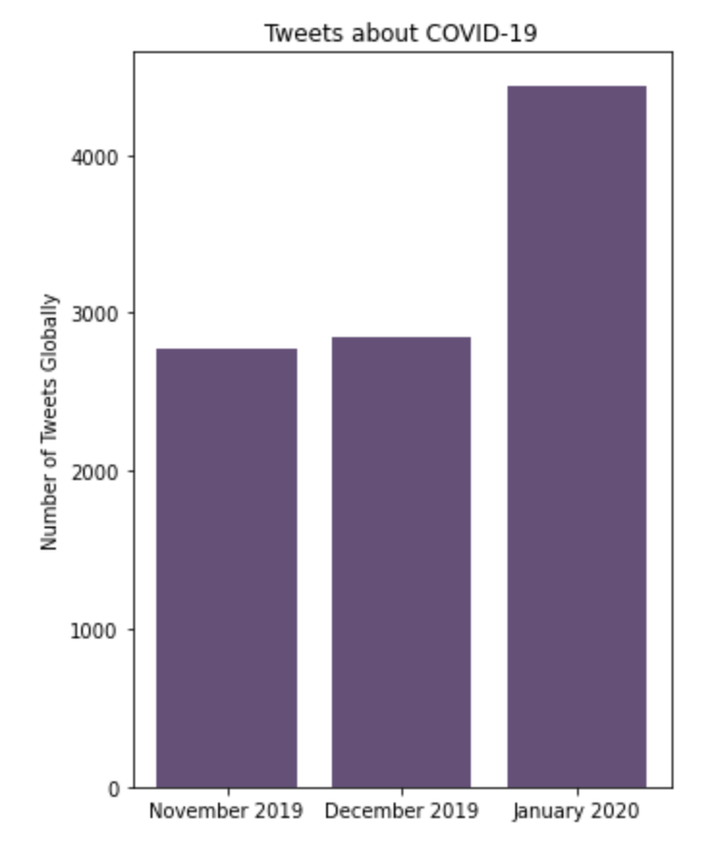
Number of Tweets Globally
This shows how the number of tweets about COVID-19 increased significantly in 2020.
We wanted to visualize the data around the time that COVID-19 was starting to see if there were any interesting trends in how the information spread.

Slide 6
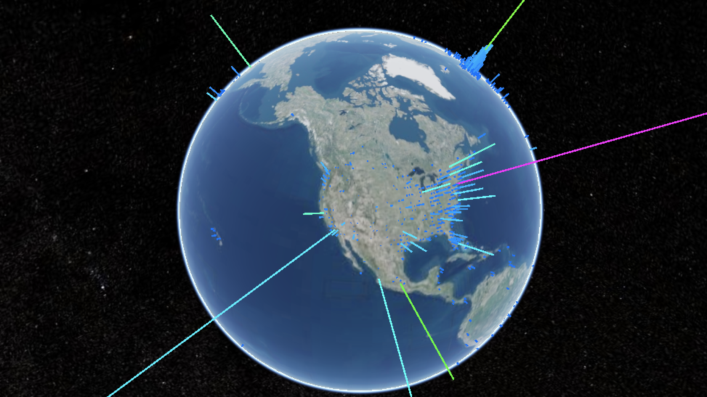
The Global Visualization
Once we had the data formatted correctly, we were able to put it on the map.

Slide 7
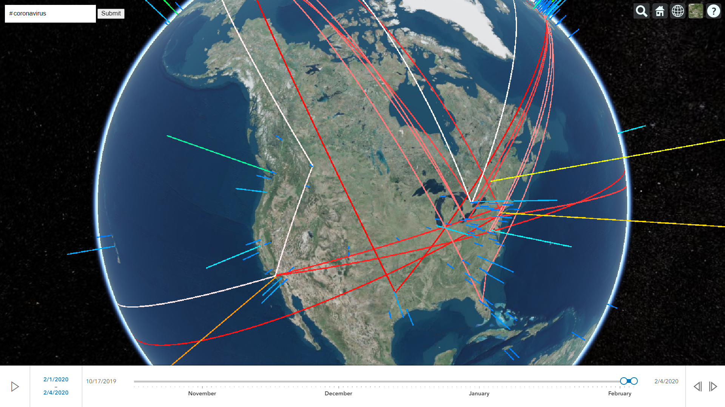
The Spread of Hashtags
The goal of this visualization is to be able to locate where certain hashtags originated and where they spread

Slide 8
Challenges
Obtaining the data
Large dataset
Hydrating took a long time
Formatting the data
Swapped longitude and latitude values
Displaying the data
Learning how to use cesium
We faced several obstacles during the process of obtaining and displaying the data, but we were able to work our way around most of those obstacles

Slide 9

Changes:
We originally wanted to show tweets about Ukraine, but we couldn’t find access to that data, so we changed it to tweets about COVID-19.

Slide 10

Questions
What would the data look like over a longer period of time?
Was the data significantly affected by our limitation of tweets with geolocation?

